Slide 1



FALL DESIGN
PRESENTATION
Team SSA
PRESENTED BY:
NAME OF PROJECT:
Saugat Neupane
Sabal Dahal
Aayush Pokhrel
AI-Powered Inventory Management System

Slide 2


03 | Names
04 | Purpose and Goals
05 | Project Abstract
06 | User Stories & Design Diagrams
08 | Project Constraints
09 | Review of Project Progress
10 | End of Term Expectations
11 | Division of Work
Overview
12
Final Demo

Slide 3

Our team
03
Saugat Neupane
Sabal Dahal
Aayush Pokhrel
N/A
neupansa@mail.uc.edu
dahalsl@mail.uc.edu
pokhreah@mail.uc.edu
Advisor

Slide 4


04
Purpose and Goals
To automate and streamline inventory management using AI-driven image recognition and real-time tracking.
Goal # 1
Goal # 2
Goal # 3
Goal # 4
Develop a deep learning model for object recognition.
Integrate a secure backend and scalable database
Create a user-friendly dashboard for monitoring and alerts.
Reduce manual effort, human error, and reporting delays.

Slide 5
05
Project Abstract
Our project focuses on developing an AI-powered inventory management system that combines deep learning for image recognition with a robust backend database for automated stock tracking. The system allows users to add, remove, and monitor inventory in real time through an intuitive dashboard. Using technologies like TensorFlow, PostgreSQL, and React, our solution aims to minimize manual data entry and reduce reporting errors. The project enhances operational efficiency by providing visual insights and real-time alerts for low-stock conditions, ultimately supporting data-driven decision-making in warehouse or retail environments.

Slide 6
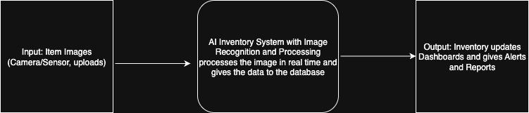

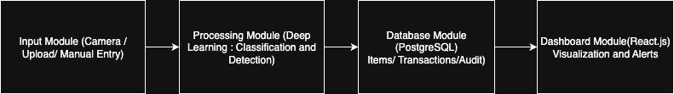
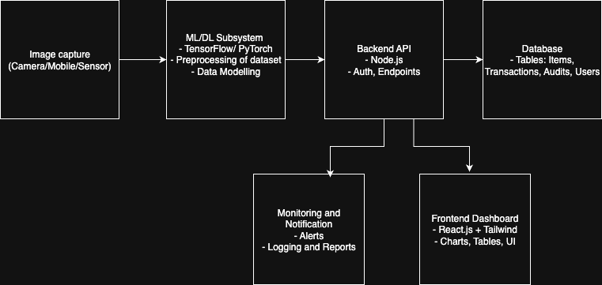
06
Design Diagram

Slide 7
07
User Stories
  Warehouse Manager: Wants real-time automated stock tracking → reduces human error and delays
  Retail Store Employee: Wants to scan/update items via image recognition → simplifies product management
  Business Owner: Wants low-stock alerts → enables timely restocking and prevents lost sales
  Data Analyst: Wants access to historical inventory data → supports demand forecasting and decision-making
  Laboratory Technician: Wants accurate tracking of sensitive items → ensures compliance and minimizes waste

Slide 8

01
Economic: Limited budget; relies on open-source libraries and UC resources.
08
02
Security: Focus on data integrity and secure API endpoints.
Project Constraint
03
Ethical: Ensure transparent model use; no misuse of data.
There are several major project constraints that our project faces and we must traverse through that for the duration of our project
04
Professional: Project enhances real-world engineering and data analysis skills.

Slide 9
Current Progress
09
This is where we currently stand in terms of progress on our project.
Current Status:
  Literature review and baseline ML model research
  Database schema and API design underway.
  Frontend design being drafted.
  System integration planned for mid-November.

Slide 10
10
Expected Accomplishments
End of Fall Semester Expected Results
  Completion of literature review and selection of the baseline deep learning model.
  Successful data collection and preprocessing for initial model training.
  Implementation of the machine learning training pipeline and initial evaluation.
  Backend architecture established, including database schema and foundational API setup.
  Initial frontend dashboard design drafted with planned features.
  Preliminary integration testing between backend and ML components initiated.
  Clear roadmap established for model refinement, frontend implementation, and full system integration in Spring 2026.

Slide 11

11
Division of Work
Team Member | Primary Responsibility
Sabal | ML/DL Development: Image recognition model, preprocessing, training
Aayush | Backend & Database: Schema design, APIs, integration, authentication
Saugat | Frontend/UI Design: Dashboard UI, alerts, visualization, documentation
A LOT OF WORK SUCH AS SYSTEM INTEGRATION, DOCUMENTATION, TESTING AND RESEARCH WILL TAKE COMBINED EFFORT FROM THE ENTIRE TEAM BUT THE PRIMARY RESPONSIBILITIES HAVE BEEN DIVIDED AS MENTIONED IN THE TABLE.

Slide 12
12
Expected Demo
End of Project Expected Results
  Real-time object detection and item logging.
  Interactive dashboard with inventory visualization.
  Low-stock alert notification feature.
  Walkthrough of backend integration and model performance.

Slide 13
Thank you

